Slide 1


CACIB
TECHTALK
Notes:
Proceed to next slide

Slide 2
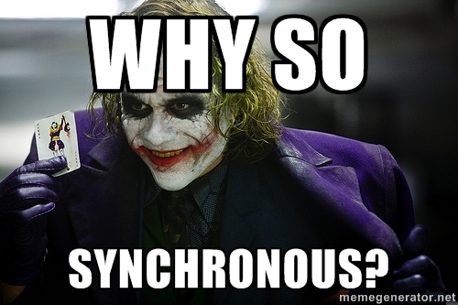
we tend to think…
SYNCHRONOUSLY
Notes:
Left to right
Top to bottom
Normally we want our program to execute
Block of code
This line first then this line

Slide 3
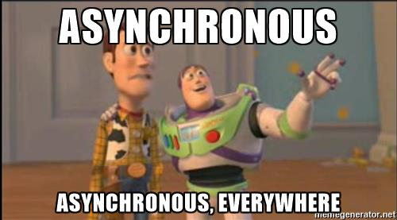
but mostly work… ASYNCHRONOUSLY
Handling user inputs
Animations
Websockets
API calls
Notes:
But when it comes to front-end devt
Mostly our work deals with asynchronous objects and events
Some of our code can run separately from the main application thread so that it will not cause any blockings
You might have seen of some websites wherein you input a text on a searchbox and while you type, results are returned
UI not blocked, the application has been able to react to the user inputs without sacrificing the user experience
That’s the wonder of async programming

Slide 4
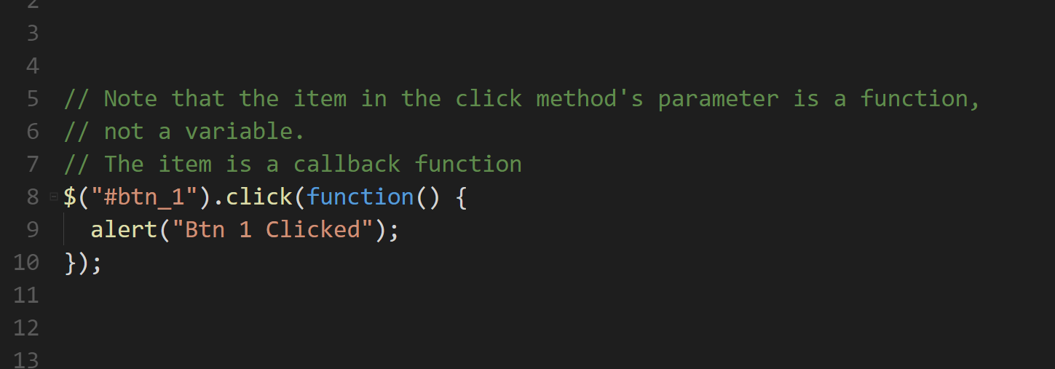
Notes:
When we work with async, we work usually callbacks
A callback is something that we pass on another piece of code, and we expect that piece of code to “call back” or execute the thing that we pass to it at a given time

Slide 5

Notes:
But there’s one problem with callbacks
Whether we like it or not, we are sometimes forced to do this

Slide 6
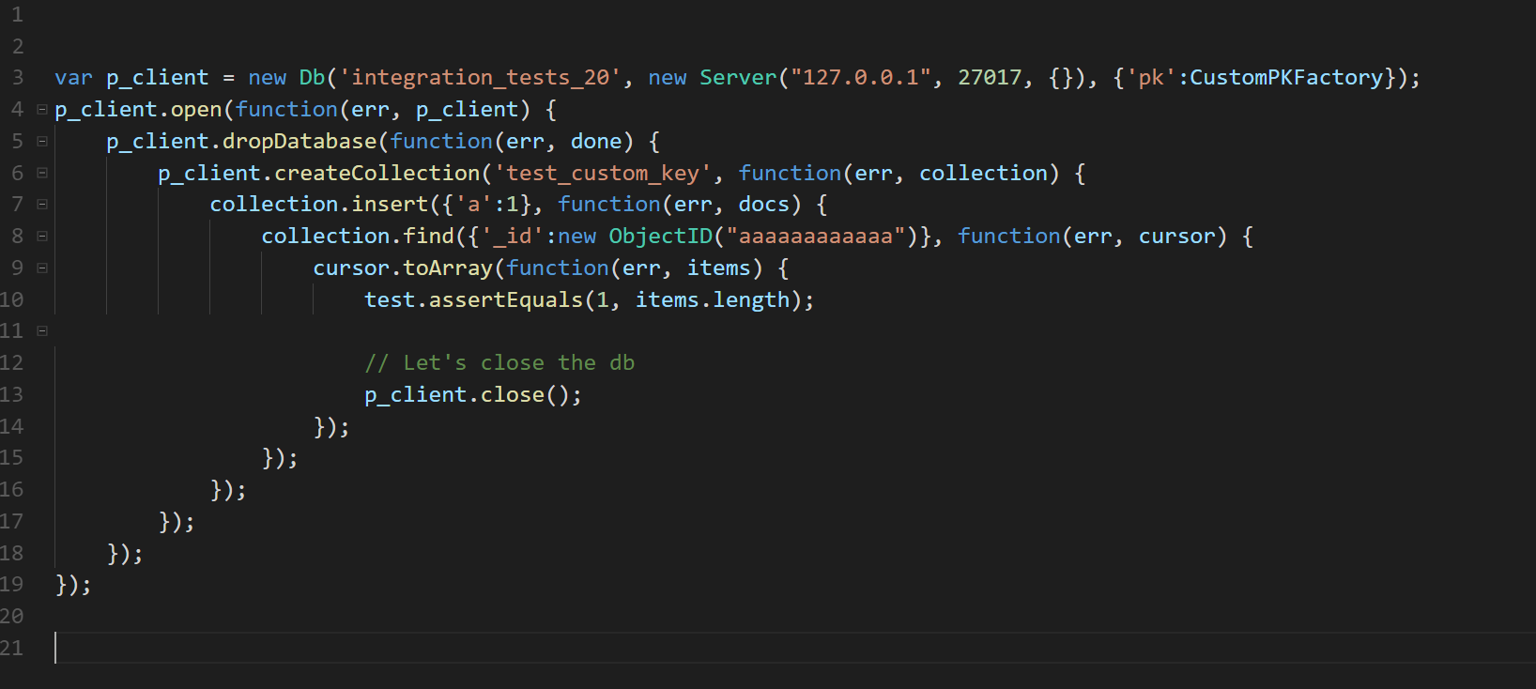
Notes:
And that thing is called callback hell
Lots of nested callbacks in this example
usually this is caused by behavioral dependencies,
Callback function execute after a function
But callback function will execute another function because you want it to..

Slide 7
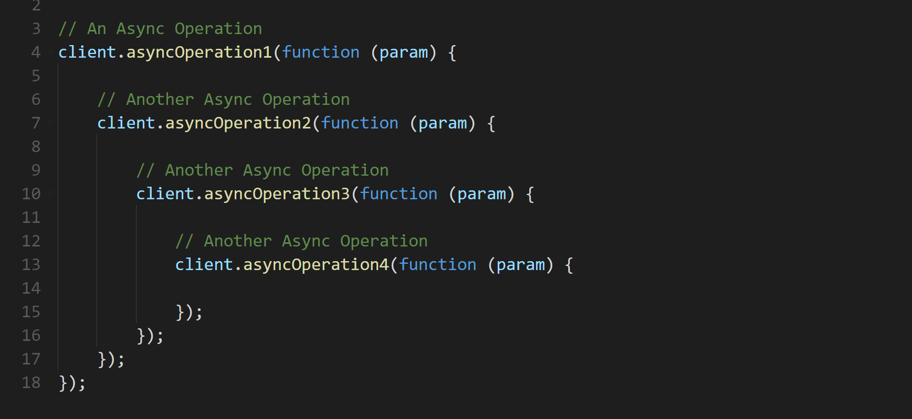
Notes:
Async after async operations
If there are so many nested callbacks, your code get harder to read and maintain
There’s got to be a better way, a more elegant way to handle async callbacks
And the answer for that is called promises

Slide 8
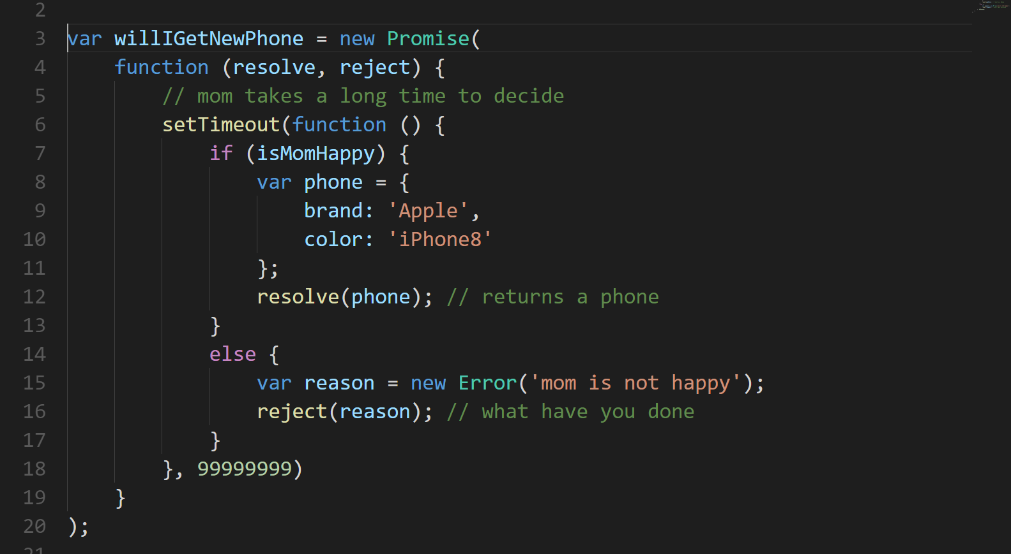
Notes:
Who used promises here before?
Id say if you are working with Jquery, this is something like success fail methods of the jquery ajax calls
The Promise object represents the eventual completion (or failure) of an asynchronous operation, and its resulting value
In this simple example of a promise….

Slide 9
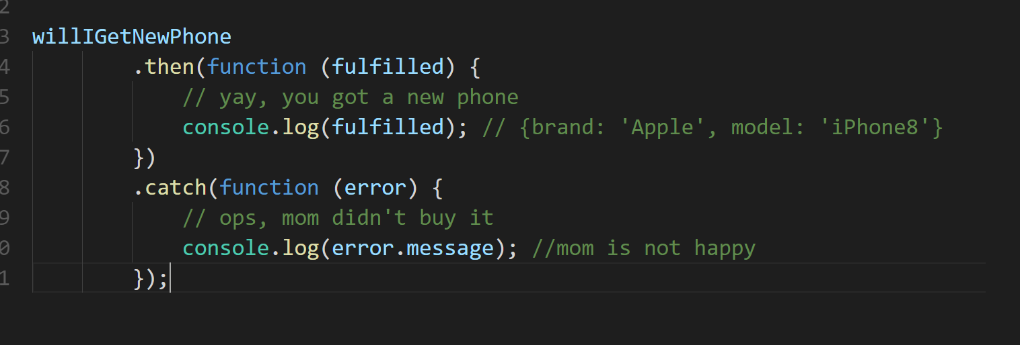

Slide 10
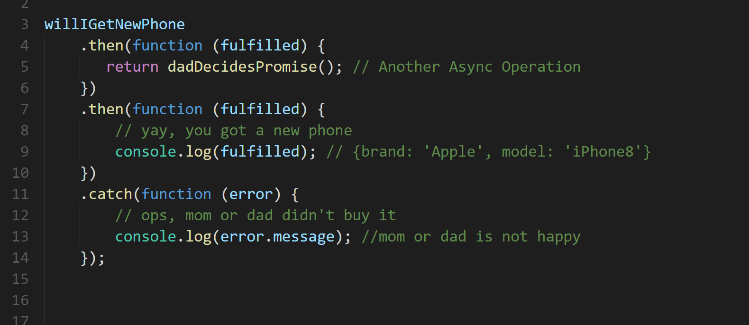

Slide 11
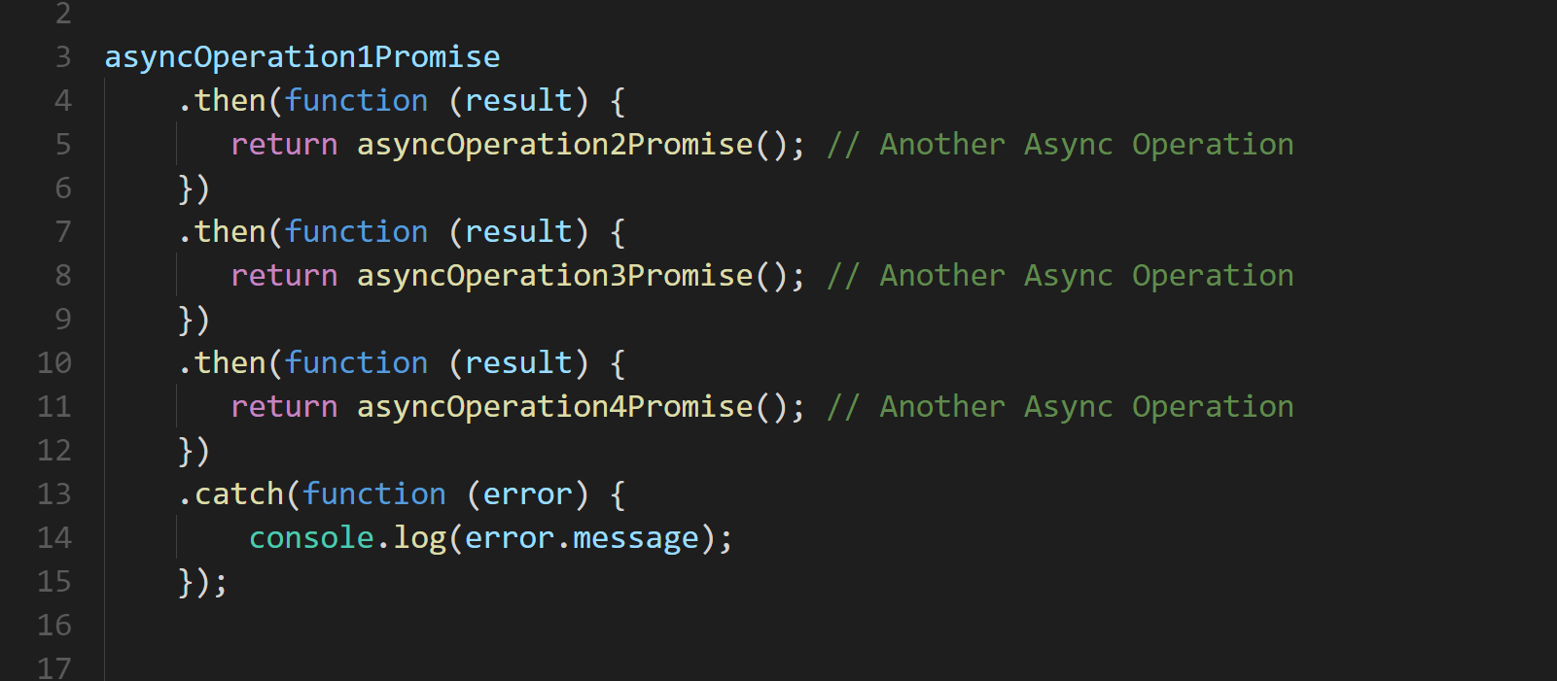
Notes:
Promises help us to better handle async

Slide 12


Notes:
Retry a promise
Cancel a promise
One promise multiple values?

Slide 13
Reactive Extensions for Javasript WHY YOUR PROMISE IS NOT ENOUGH? (AND HOW TO BREAK IT!)
Rogeross Beraña
RFI Software Engineer
CACIB TECHTALK
Notes:
So hello everyone, im here to share to you a new and exciting way of handling async operations
In case you’re wondering who am I, I am not from a startup company, im not a ceo, im not a tech evangelist.. I am roj From rfi.. And this is my o

Slide 14

Angular
a JavaScript framework that helps developers build applications
https://angular.io/
Notes:
Notice I don’t put 2 or 4

Slide 15

Reactive Extensions for Javascript
set of tools allowing us to operate on sequences of data (usually asynchronous)
http://reactivex.io/
Notes:
In short rxjs
It is a library, a script library you can get from NPM
And please take note, this is the de facto way of working with asynchronous operations in Angular
If you will be working with a project with async operations, I would recommend give RxJS a chance
It takes a little bit to grow on you, but once you get what it does, its really powerful.

Slide 16
Reactive Extensions for JAVASCRIPT
.NET
JAVA
SWIFT
http://reactivex.io/
KOTLIN
SCALA
Notes:
Then history:
first release 2009 for .NET
Created by Matt Podwysocki
As a part of an internal Microsoft project
Then Java by Netflix
Then Netflix started creating a lot of talks with RxJs open source github

Slide 17






http://reactivex.io/
Notes:
Some of the users now
Community drive project spearheaded by contributors from Microsoft, Google and Netflix

Slide 18
OBSERVABLES
http://reactivex.io/
Notes:
We’ll talk about why it is so cool as we move along
So before giving you codes of observables, in order for you to have an initial idea of what observables are, what im gonna do is to give a comparison of promises and observables

Slide 19
PROMISE
An operation that hasn’t completed yet, but is expected in the future
Used with async/deferred operations
Can be hooked to a callback
PROMISES
and
OBSERVABLES
Notes:
Promises are great because u can fire up an async operation, and promises you a future data.
Great with async operations
And you can have a success and error callback and you’re good to go

Slide 20
OBSERVABLES
An object that can be subscribed to by other objects (observers)
Can return multiple values over time – an async data stream
Event based
PROMISES
and
OBSERVABLES
Notes:
This is actually a very different way of to work with async call
First off, with promise, once you get the data, its done
What if your async source wanted to send multiple piece of data,
That’s not good with promise, you need to rehook again observables allow us to subscribe to a stream of data overtime
Anybody here heard about websockets, signalr?
Server pushes data overtime, for example stock quotes

Slide 21
PROMISES OVERVIEW
CALL
I’M A DATA
Angular Service
PROMISE
Angular Component

Slide 22
OBSERVABLES OVERVIEW
I’M A DATA
I’M A DATA
I’M A DATA
SUBSCRIBE
OBSERVABLE
OBSERVER
Angular Service
Angular Component

Slide 23
OBSERVABLES OVERVIEW
26.5
27.1
21.8
SUBSCRIBE
OBSERVABLE
OBSERVER
Angular Service
Angular Component
Notes:
Stock market

Slide 24
PROMISES and OBSERVABLES overview
PROMISES
Returns a single value
Cannot cancel
Natively supported in browsers
OBSERVABLES
Can return multiple values overtime
Can cancel
Relies on library such as RxJS (for now)
Support standard array functions (map, filter, reduce, etc.)

Slide 25
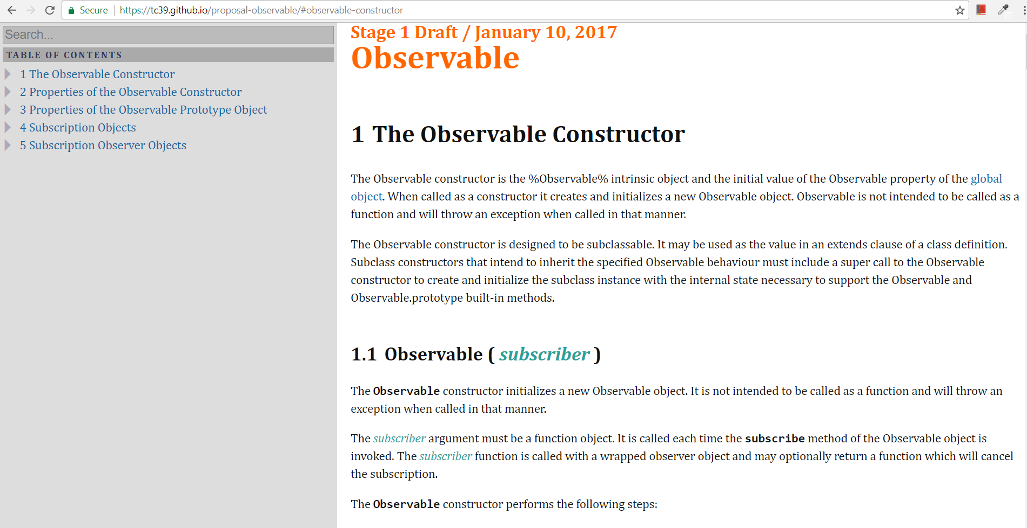
Observable Stage 1 Draft
https://tc39.github.io/proposal-observable

Slide 26
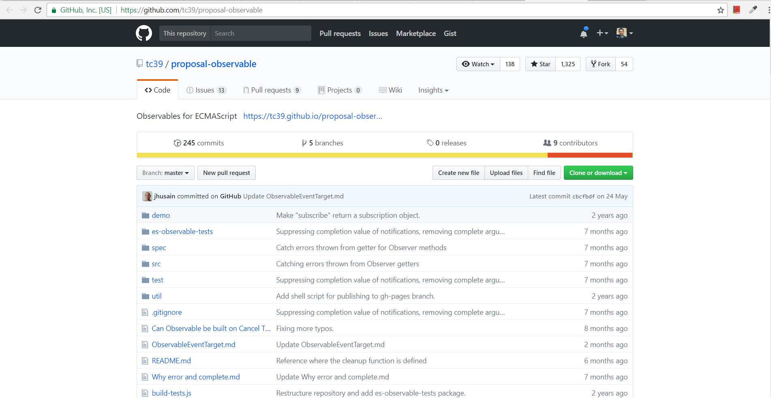
Observable Github Repo
https://github.com/tc39/proposal-observable

Slide 27
Angular and RxJS MAKE ASYNC GREAT AGAIN
CACIB TECHTALK

Slide 28
Rx IMPORTANT CONCEPTS
OBSERVABLE
SUBSCRIPTION
OBSERVER
next( )
error( )
complete( )
Notes:
Observable wrapper of data

Slide 29
Rx IMPORTANT CONCEPTS
OBSERVABLE
OBSERVER
next( )
error( )
complete( )
OBSERVABLE

Slide 30
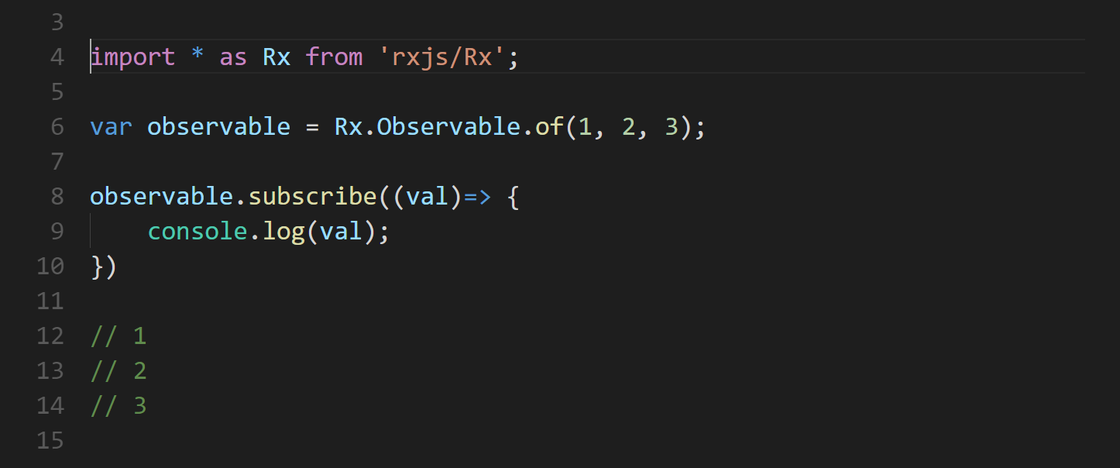

Slide 31
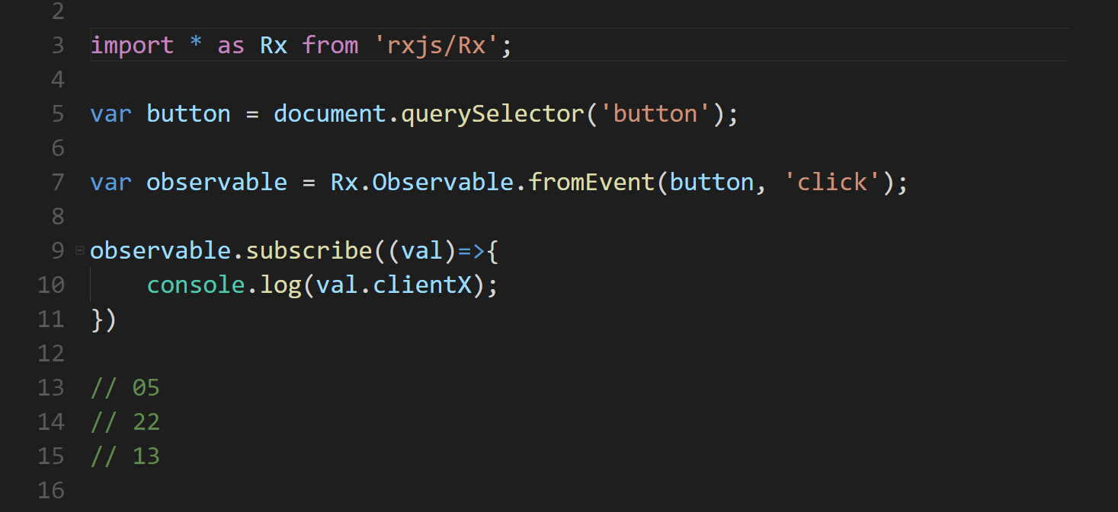

Slide 32
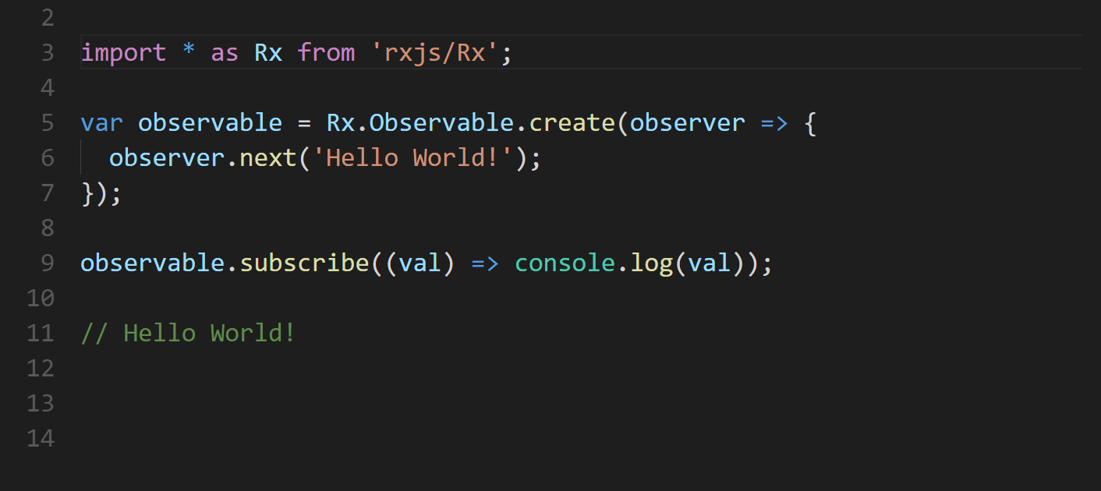

Slide 33
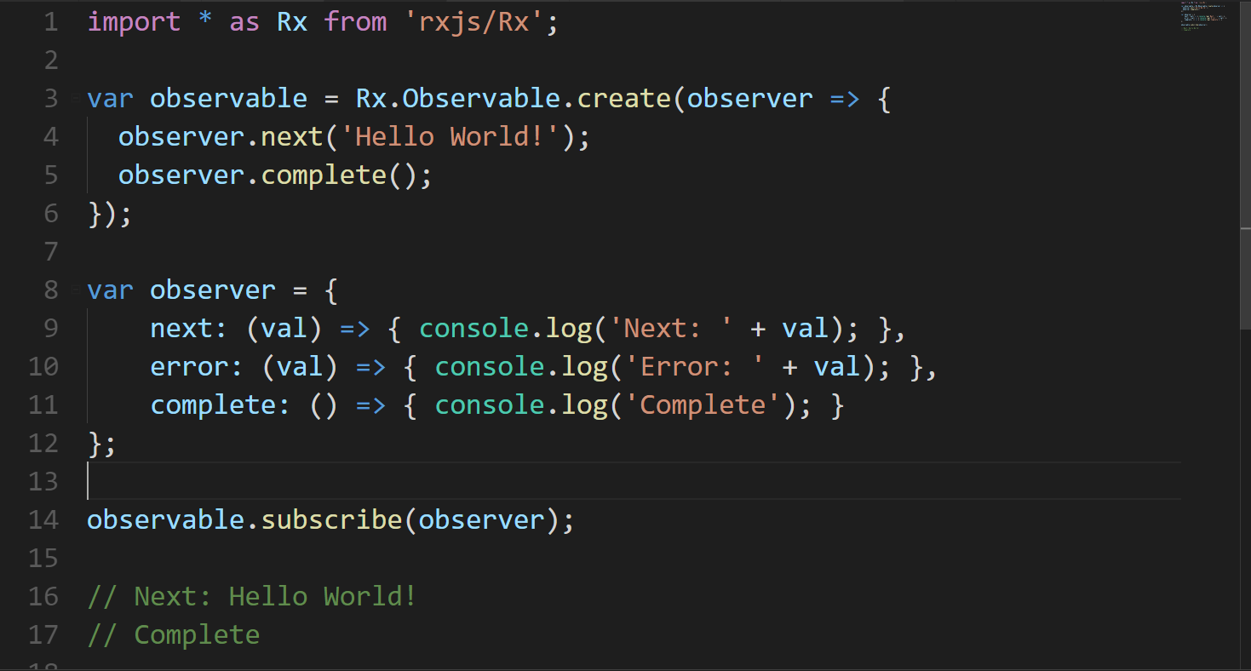

Slide 34
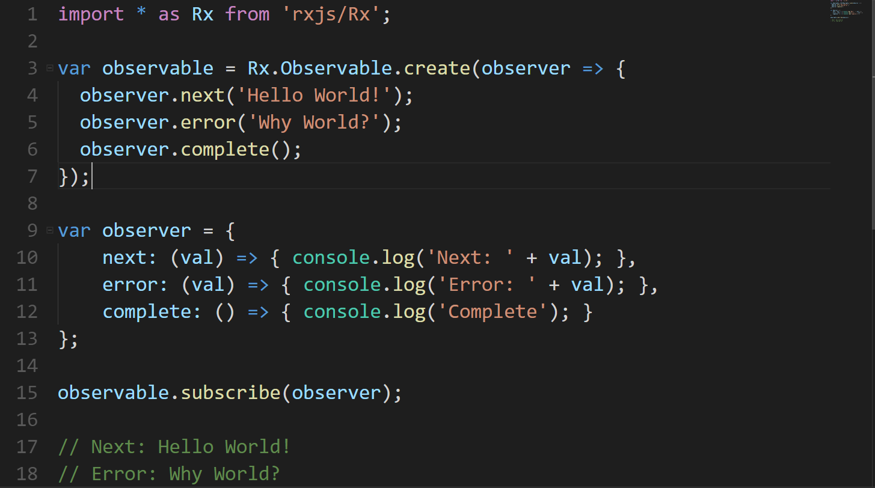

Slide 35
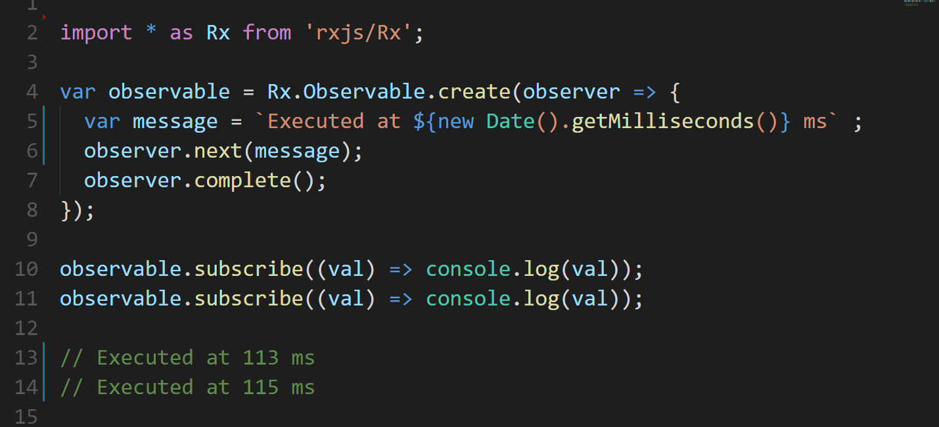
COLD OBSERVABLE
Notes:
Cold observable
Async process executed during subscribe

Slide 36
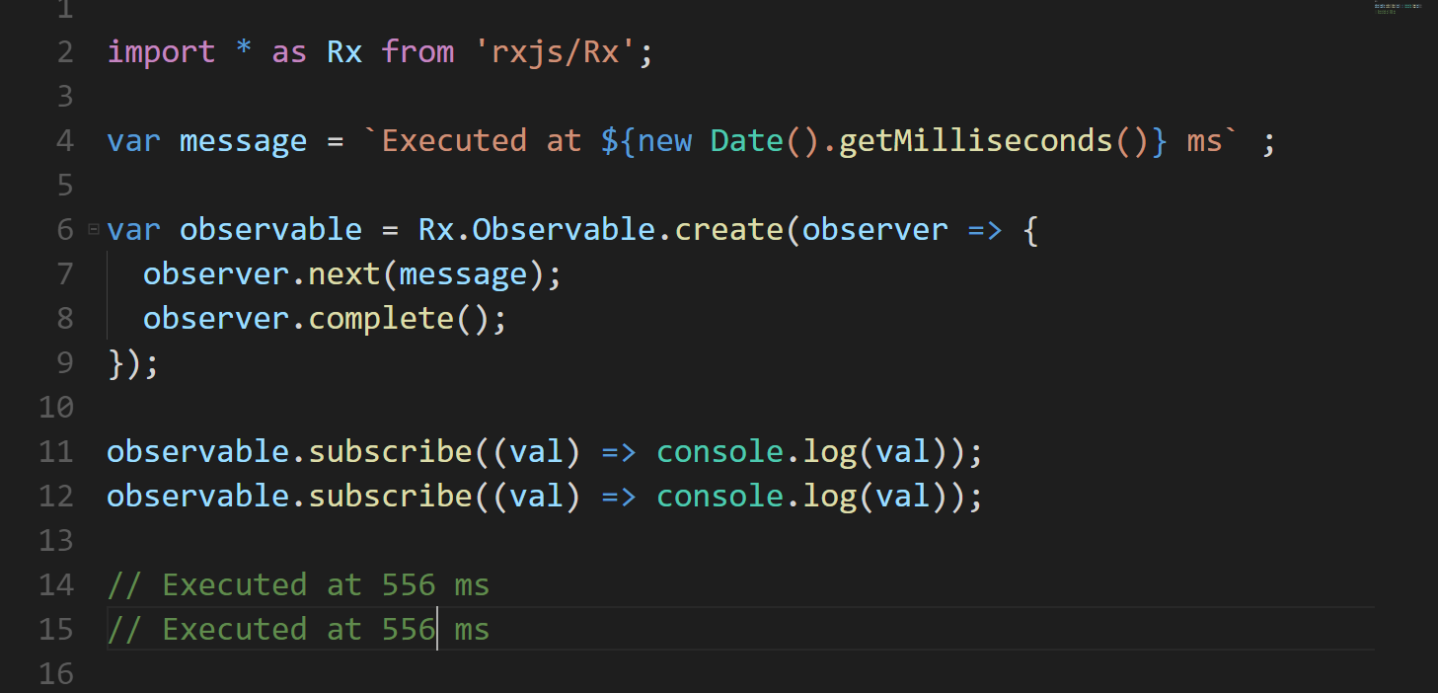
HOT OBSERVABLE
Notes:
Hot observable

Slide 37
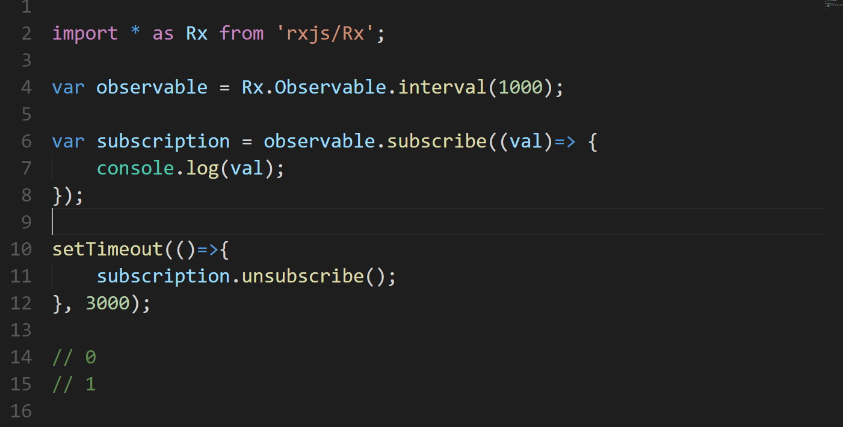
SUBSCRIPTION
Notes:
Hot observable

Slide 38
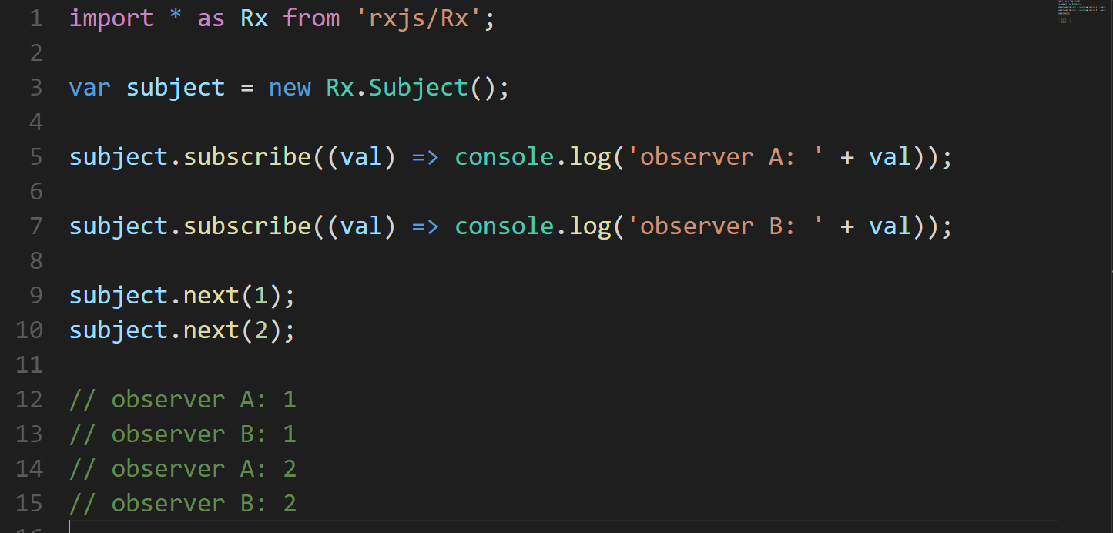
SUBJECT
Notes:
Hot observable

Slide 39
OPERATORS
CREATION
from
interval
of
timer
COMBINATION
combineLatest
concat
merge
race
startWith
withLatestFrom
zip
MATH
count
max
min
reduce

Slide 40
OPERATORS
FILTERING
debounce
distinct
elementAt
filter
find
first
sample
skip
take
throttle
TRANSFORMATION
buffer
concatMap
map
mergeMap
pairwise
pluck
repeat
scan
switchMap
switchMapTo
UTILITY
delay
delayWhen

Slide 41
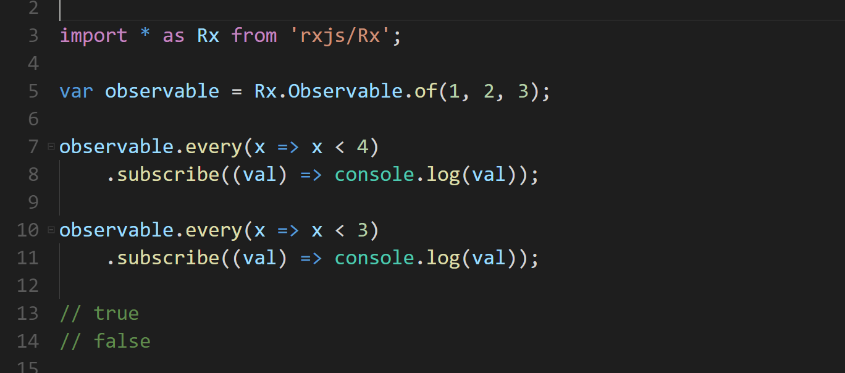
EVERY OPERATOR

Slide 42
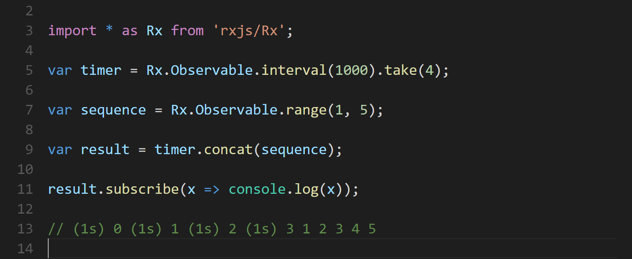
TAKE & CONCAT OPERATOR

Slide 43
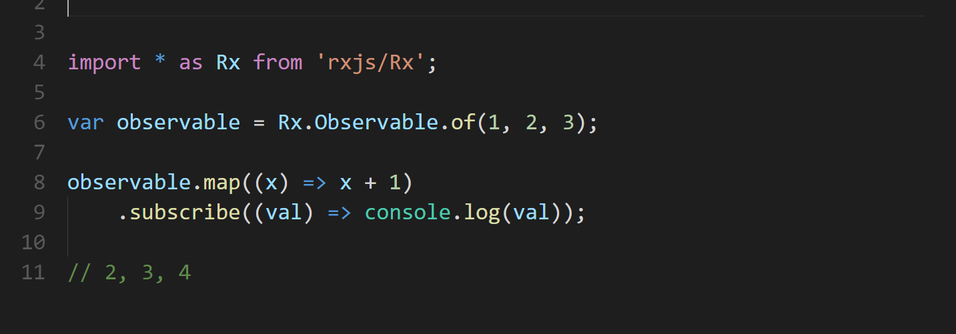
MAP OPERATOR

Slide 44
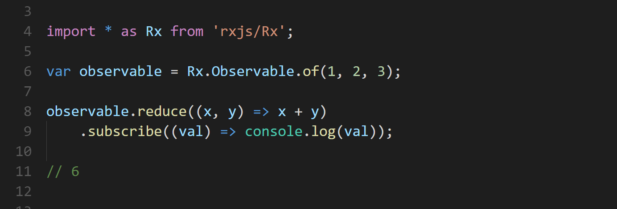
REDUCE OPERATOR
Notes:
Compare to scan

Slide 45
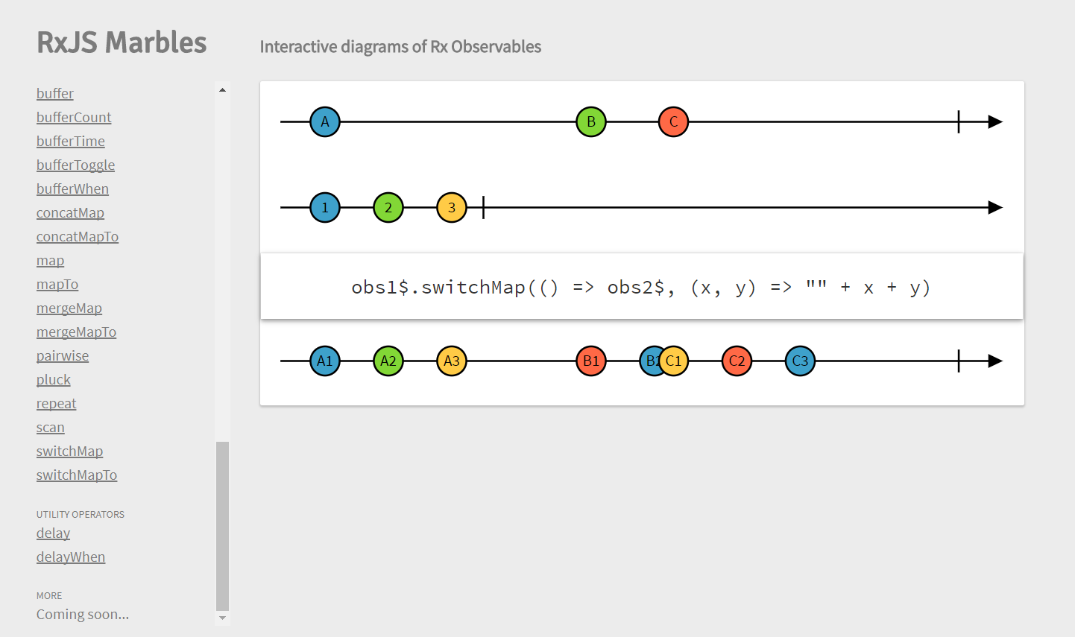
http://rxmarbles.com

Slide 46
Angular and RxJS DEMO
CACIB TECHTALK

